Slide 1

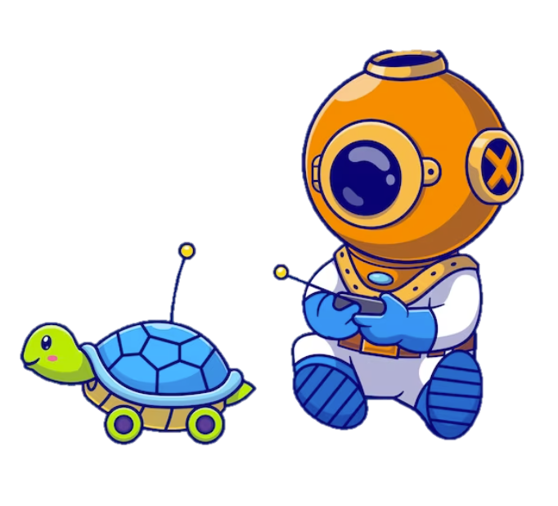
Machine
Learning
Demystifying the World of Artificial Intelligence and Exploring Its Potential

Slide 2
Machine Learning
Task Driven
Data Driven
Supervised Learning
Unsupervised Learning
(Pre-Categorized Data)
(Unlabeled Data)
Classification
Regression
(Divide the Socks by Color)
(Divide the Ties by Length)
Dimensionality Reduction
Clustering
Association
E.g. Identify Fraud Detection
E.g. Market Forecasting
Obj: Predications + Predictive Models
(Divide the Similarity)
(Identify Sequences)
(Wider Dependencies)
E.g. Targeted Marketing
E.g. Customer Recommendation
E.g. Big Data Visualization
Obj: Pattern/ Structure Recognation
Machine Learning

Slide 3
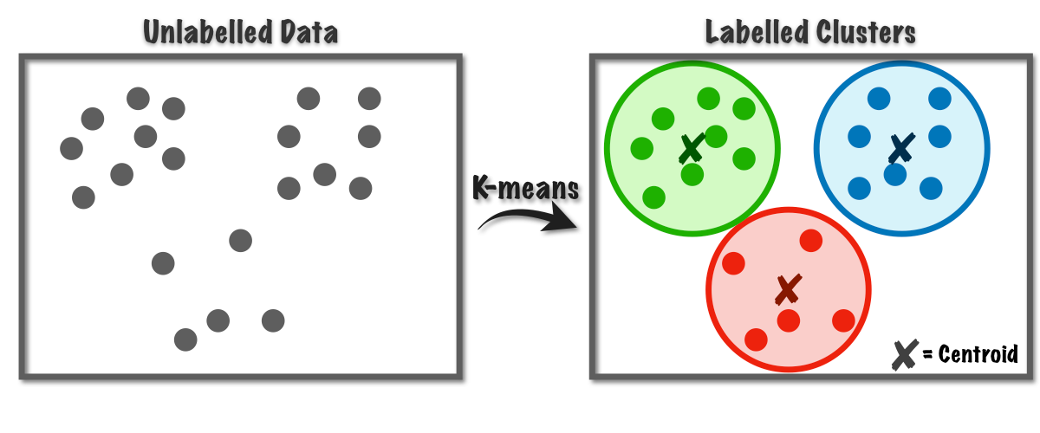
K-Means Clustering
an unsupervised learning algorithm used for data clustering, which groups unlabeled data points into groups or clusters.
Machine Learning

Slide 4
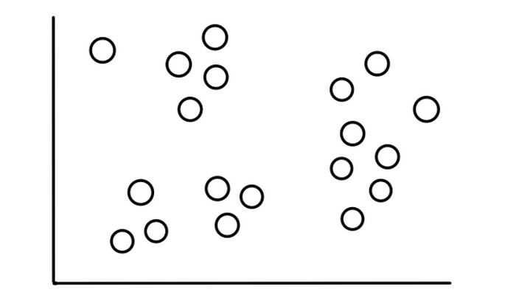
K-Means Clustering
Imagine we have 19 data points that look like this:
Machine Learning

Slide 5
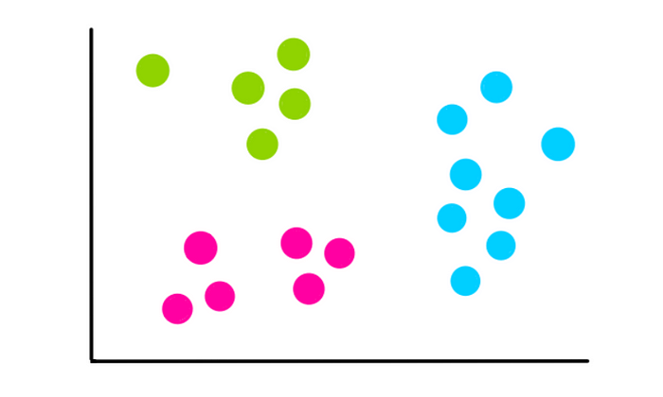
K-Means Clustering
Now assume that we know this data fits into 3, relatively obvious, categories that look like this:
Machine Learning

Slide 6
K-Means Clustering
Our task is to use the k-means Clustering algorithm to do this categorization.
Machine Learning

Slide 7
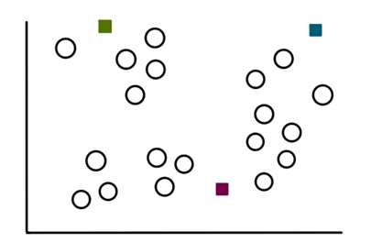
K-Means Clustering
Step 1: Select the Number of Clusters, k
The number of clusters we want to identify is the k in k-means clustering. In this case, since we assumed that there are 3 clusters, k = 3
Step 2: Select k Points at Random
We start the process of finding clusters by selecting 3 random points (not necessarily our data points). These points will now act as centroids, or the center, of clusters that we are going to make:
Machine Learning

Slide 8
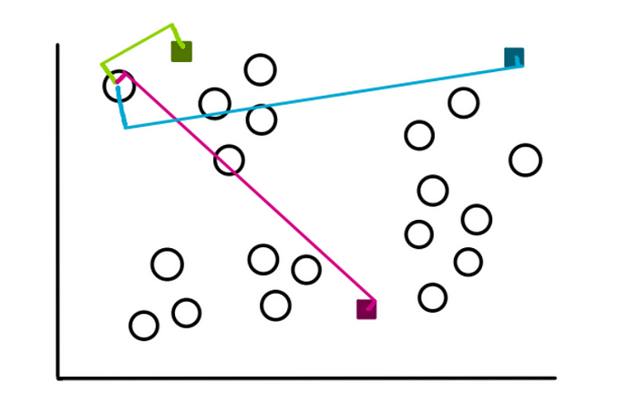
K-Means Clustering
Step 1: Select the Number of Clusters, k
Step 2: Select k Points at Random
Step 3: Make k Clusters
To make the clusters, we start by measuring the distance from each data point to each of the 3 centroids. And we assign the points to the cluster closest to it. So, for a sample point, the distances will look like this:
Machine Learning

Slide 9
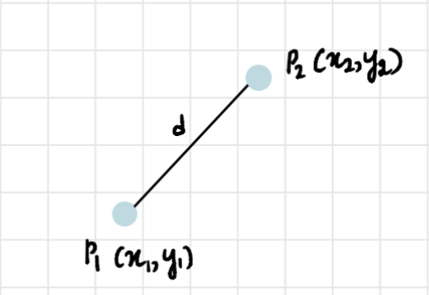

K-Means Clustering
In two dimensions, the formula to find the distance between two points is:
Machine Learning

Slide 10
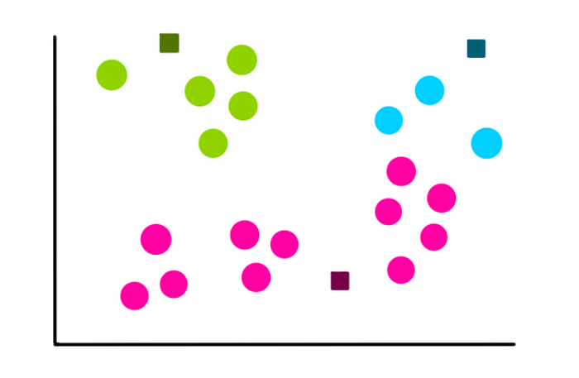
K-Means Clustering
Using the above formula, we repeat this process for the rest of the points and the clusters will look something like this:
Machine Learning

Slide 11
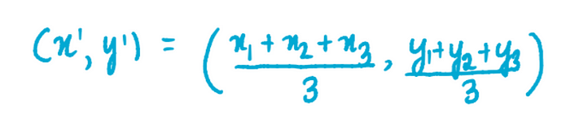
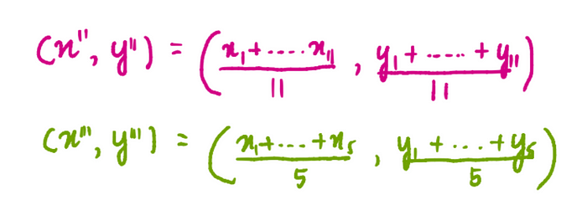
K-Means Clustering
Step 4: Compute New Centroid of Each Cluster
Now that we have our 3 clusters, we find the new centroids formed by each of them. For instance, the way we calculate the coordinates of the centroid of the blue cluster is:
Machine Learning

Slide 12
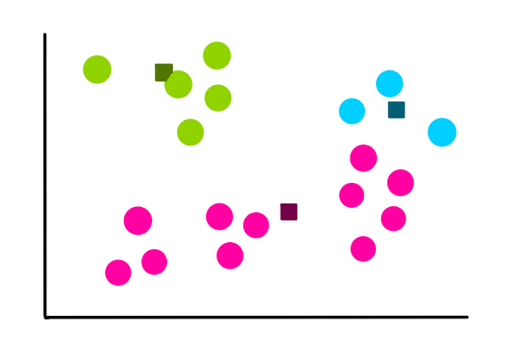
K-Means Clustering
Step 4: Compute New Centroid of Each Cluster
Machine Learning

Slide 13
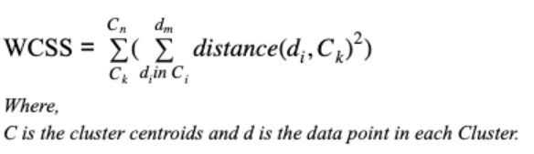
K-Means Clustering
Step 5: Assess the Quality of Each Cluster
Since k-means can’t see the clustering as we can, it measures the quality by finding the variation within all the clusters. The basic idea behind k-means clustering is defining clusters so that the within-cluster variation is minimized. We calculate something called Within-Cluster Sum of Squares (WCSS) to quantify this variance:
Machine Learning

Slide 14
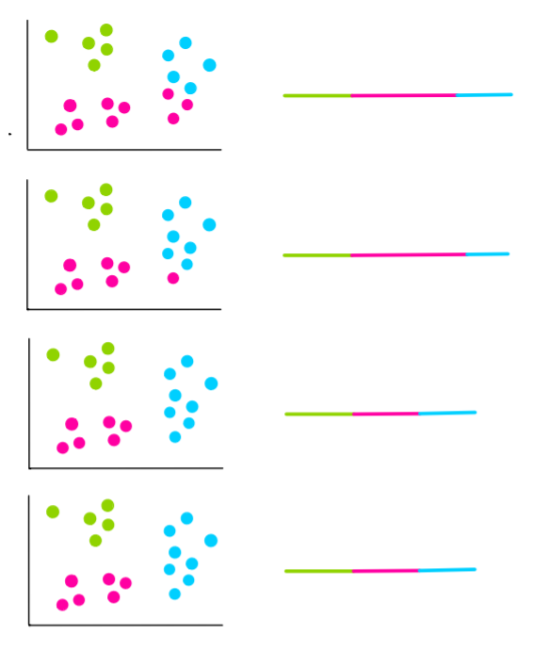
K-Means Clustering
Step 6: Repeat Steps 3–5
Machine Learning

Slide 15
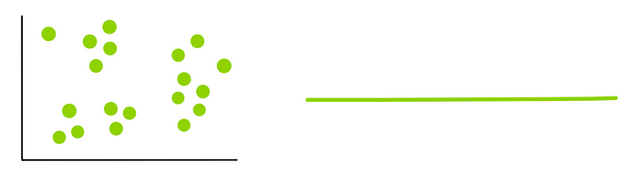
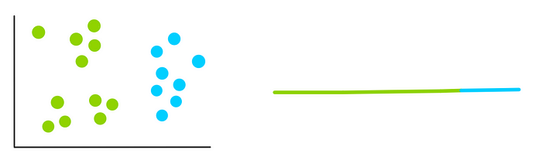
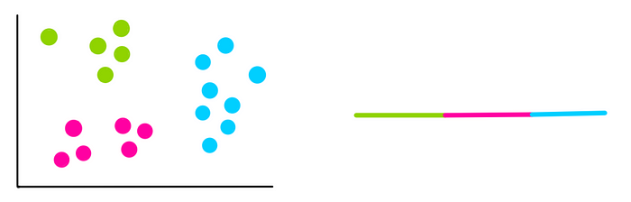
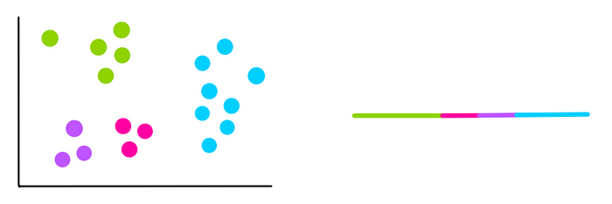
How do we choose k?
In our example, we conveniently knew that we need 3 clusters. But what if we don't know how many clusters we have, then how do we choose k? In this case, we try multiple k values and calculate the WCSS.
k=1:
k=2:
k=3:
k=4:
Machine Learning

Slide 16
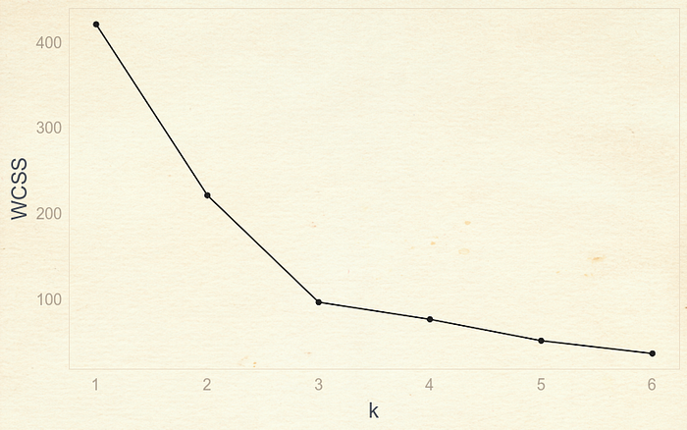
How do we choose k?
So, we need to use something called an elbow plot to find the best k. It plots the WCSS against the number of clusters or k.
Machine Learning

Slide 17
THANK YOU!
Any Question!

